Slide 1
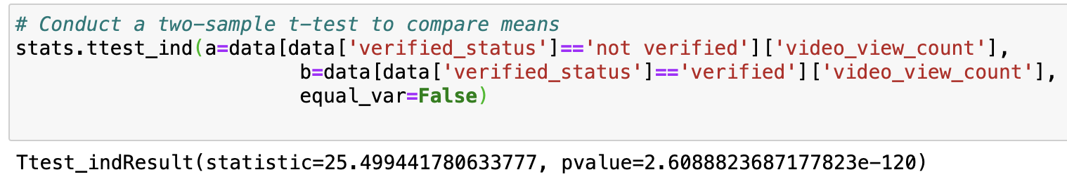
Statistical Testing
Verified vs Unverified Users
A two sample t-test will be conducted to assess if there is a difference between verified and unverified users in terms of view count.
Assess if unverified users receive more views on average compared to verified users.
The results indicated a p-value well below the threshold of 0.05. Therefore, the null hypothesis can be rejected. This means that it is very likely that the observed differences in view count are not due to chance.
The machine learning model should examine author status as unverified authors tend to get more views and are therefore more likely to post claims.

